Slide 1
Detecting Block Cipher Encryption for Defense against Crypto Ransomware on Low-end Internet of Things
Hyunji Kim, Jaehoon Park, Hyeokdong Kwon, Kyoungbae Jang,
Seungju Choi, and Hwajeong Seo
khj1594012@gmail.com

Slide 2
Crypto Ransomware
Previous Works
Proposed Method
Evaluation
Conclusion

Slide 3





Crypto Ransomware
A crypto ransomware encrypts files of victims using block cipher encryption.
The ransomware virus has became a massive threat of people with digital devices.
It is necessary to defend against ransomware.
1) The hacker requests a ransom for encrypted files
from the victim.
ransomware
Hackers
2) The victim pays the ransom and receives a secret key.
3) The victim recovers the encrypted file using a secret key.
Victims

Slide 4
Previous Works
Features | Grobert et al. (2011) | Lestringant et al. (2015) | Kiraz et al. (2017) | This work (2020)
Target | Block & PKC | Block Cipher | PKC | Block cipher
Analysis | Dynamic | Static | Dynamic | Static
Method | Heuristics | Data graph flow | System monitor | Deep learning
Machine | Desktop | Desktop | Desktop | Microcontroller

Slide 5



Proposed Method
1. Crypto ransomware
Cryptographic process
binary
file
(lss, hex)
2. Static analysis
Binary file
Instruction, Opcode
3. Deep learning based detection of block cipher encryption
Learning the encryption pattern through images
Convolutional Neural Networks (CNN)
4. Low-end 8-bit AVR microcontrollers
8-bit AVR ATmega128
Lightweight block cipher library and general firmware
GNU AVR-GCC compiler

Slide 6
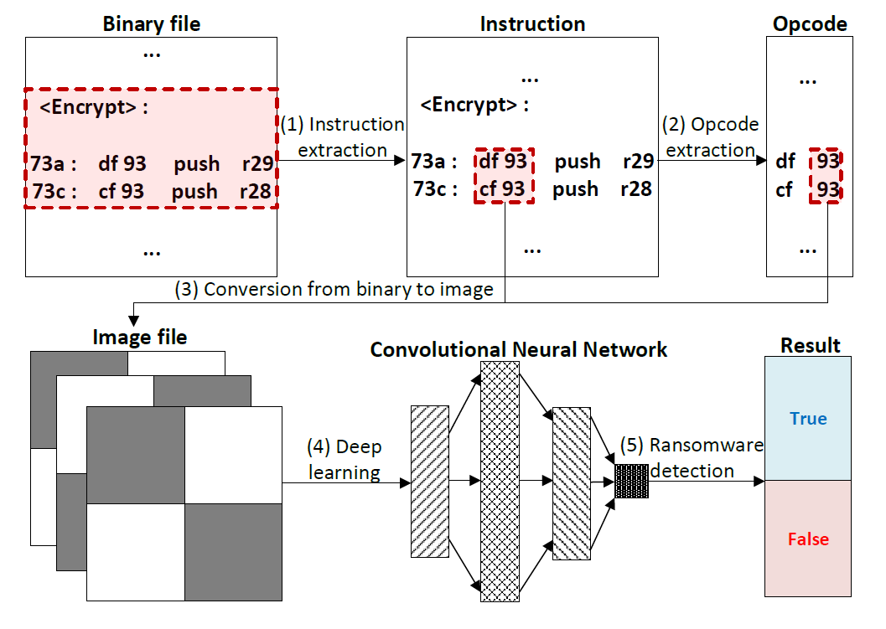
Proposed Method
*instruction (operand + opcode)

Slide 7
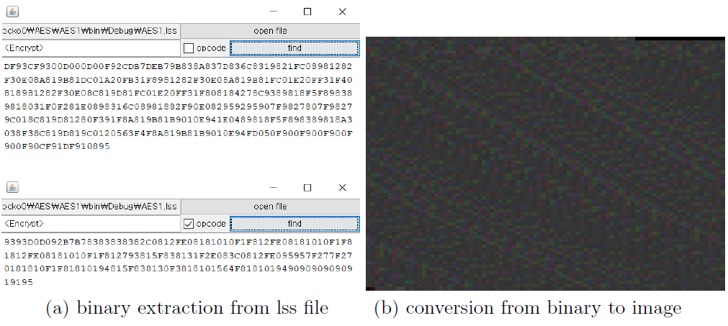
Convert instruction and opcode into image
Instruction and opcode extraction from binary file (.lss)
Image from binary

Slide 8
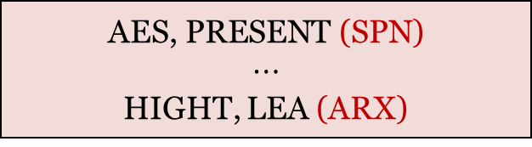
Deep learning
Feature extraction and enhancement
Training
phase
Image from binary
convolution layer
pooling layer
general firmware
general firmware
Detecting
phase
$$\text{AES}\text{, }\text{PRESENT} \text{(}\text{SPN}\text{)}$$
$⋯$
HIGHT, LEA (ARX)
crypto ransomware
Fully connected
layer
Classification and detection

Slide 9
Training phase
Repeat convolution and max pooling operation
convolution : feature extraction
max pooling : feature enhancement
Learning the operation types and patterns of the encryption process
image from binary
convolution layer
pooling layer
Feature extraction and enhancement

Slide 10

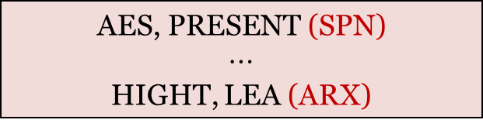
Ransomware detection phase
Detecting block cipher encryption for defense against crypto ransomware
algorithm : AES, PRESENT $⋯$ HIGHT, LEA, general firmware
architecture : SPN, ARX, general firmware
Classified as the label with the highest probability
general firmware
general firmware
$$\text{AES}\text{, }\text{PRESENT} \text{(}\text{SPN}\text{)}$$
$⋯$
HIGHT, LEA (ARX)
crypto ransomware
fully connected
layer
classification and detection
Notes:
Finally, it is classified as ransomware (block cipher) and general firmware

Slide 11
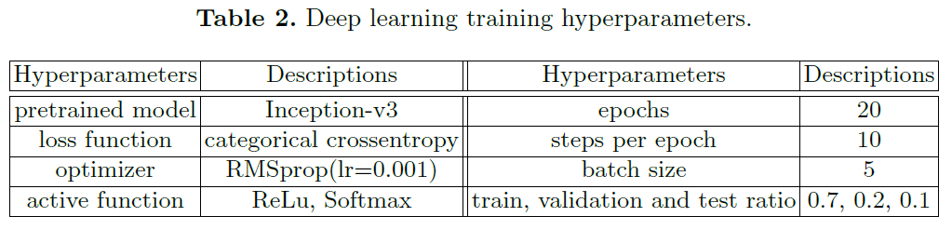
Model and Hyper parameters
Inception-v3 (pretrained weights) + 3 fully connected layers
→ To adjust the classication problem
Categorical crossentropy and Softmax
Multi-class classification
Set the optimal hyper parameter through grid search.

Slide 12
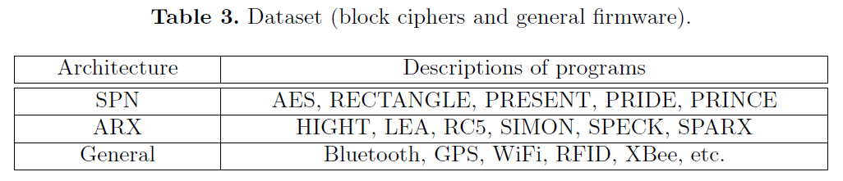
Dataset
Block cipher
Cryptographic modules written in C language among implementations of FELICS (Fair Evaluation of Lightweight Cryptographic System)
General firmware
From AVR packages
On 8-bit AVR ATmega128
Unbalanced dataset
macro and micro average
*FELICS : Fair Evaluation of Lightweight Cryptographic System

Slide 13
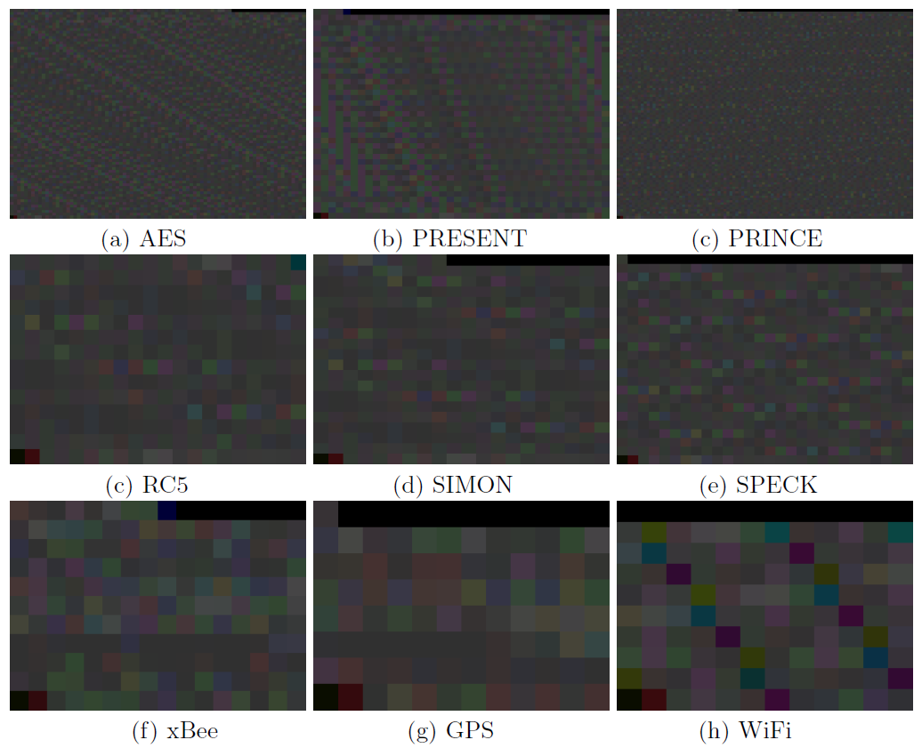
Dataset
SPN has a more complicated structure than ARX.
Images differ depending on the type or pattern of instructions used.
SPN
ARX
General

Slide 14
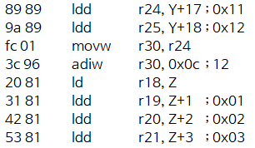
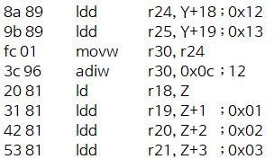
Instruction-based vs Opcode-based
The opcode is same, but the operand is slightly different.
operand
opcode
*instruction (operand + opcode)

Slide 15
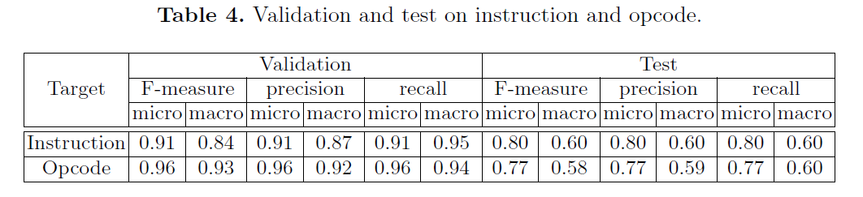
Instruction-based vs Opcode-based
Opcode-based
Stable performance for untrained data
The standard deviation for micro and macro is 0.12.
The standard deviation of the metrics for each experiment is also less opcode based.
*F-measure : a harmonic mean of precision and recall
*micro : considering the number of data belonging to each class (for each data)
*macro : considering all classes with the same weight (for label)

Slide 16
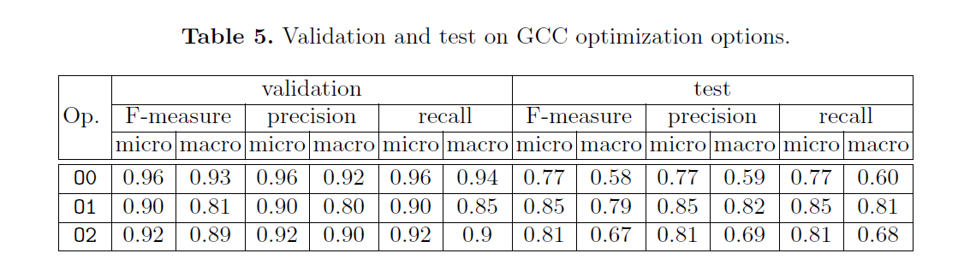
GCC optimization option (O0, O1, O2)
The extracted opcode is slightly different depending on the optimization option.
O0 : Best performance for validation dataset, but not best for test dataset
O1 : Stable and best generalization performance for test dataset (untrained data)

Slide 17
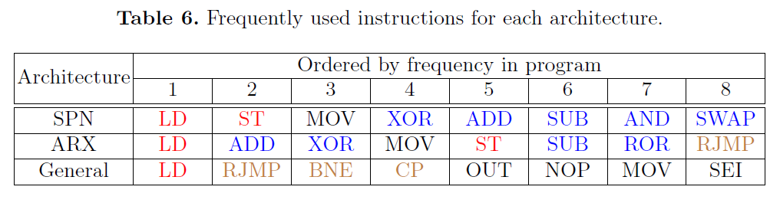

Frequently used instructions for each architecture
SPN
S-box operation → the pattern of $LD−XOR−ST$ , memory access ($LD$, $ST$)
ARX
Addition, Rotation, and eXclusive-or (arithmetic and logical operations) → $ADD, XOR, SUB$
General
interrupt function, I/O register, branch statements → $RJMP, BNE, CP$

Slide 18
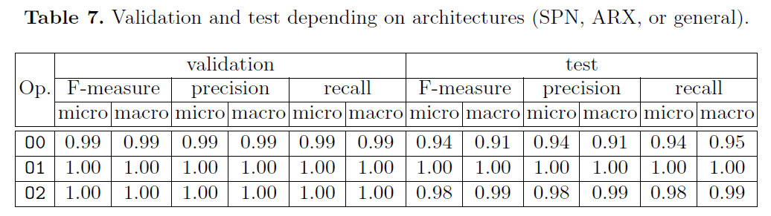
SPN vs ARX vs General
Cryptographic algorithms of the same architecture have similar patterns.
incorrect classification between algorithms with the same architecture
Classification for each architecture (SPN, ARX and General firmware, not each algorithm) achieved better performance.
It accurately predicted test data in optimization option O1.
Notes:
(in previous experiment → 잘못분류된경우는 대부분 그 .. 같은 구조끼리…였음

Slide 19
Conclusion
Contribution
Deep learning based crypto ransomware detection for low-end microcontrollers
Experiments with several options for high accuracy
Future work
Test and evaluate our method using the real ransomware samples.

